Slide 1

Add Flutter to existing app
Wenxuan Shi
College of Software, Nankai University
Email: shiwx@nankai.edu.cn
Wechat: 13920561100

Slide 2
Topics
Introduction
Adding to an Android app
Adding to an iOS app
Running, debugging & hot reload
Loading sequence and performance

Slide 3
Introduction
Notes:
StatelessWidget is used for immutable elements that only rely on the object configuration information
StatefulWidget is used for elements that can dynamically change based on state-changes in the system
Everytime that state changes, setChange() is called by the object

Slide 4
Add-to-app
In a few steps, you can bring the productivity and the expressiveness of Flutter into your own app.
It currently has the following limitations:
Running multiple Flutter instances or running in partial screen views may have undefined behavior.
Using Flutter in background mode is still a WIP.
Packing a Flutter library into another sharable library or packing multiple Flutter libraries into an application isn’t supported.
Plugins used in add-to-app on Android should undergo flutter.dev/go/android-plugin-migration and use the FlutterPlugin-based APIs.

Slide 5
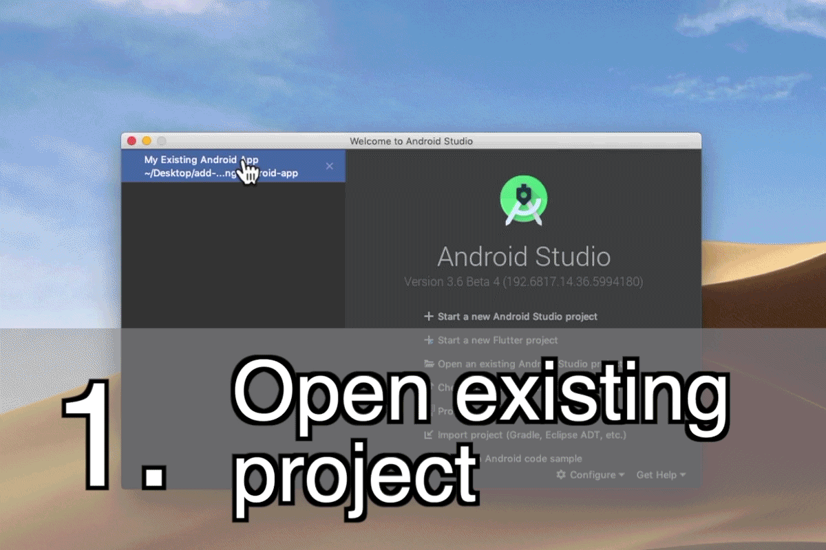
Add to Android applications

Slide 6
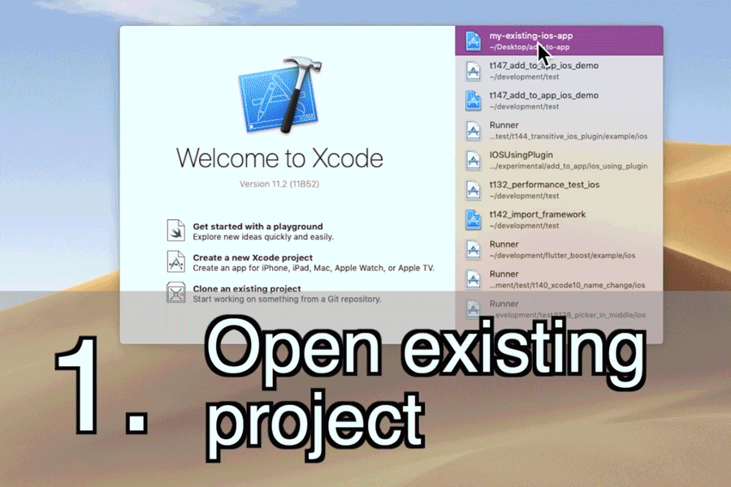
Add to iOS applications

Slide 7
Adding Flutter to Android
Notes:
StatelessWidget is used for immutable elements that only rely on the object configuration information
StatefulWidget is used for elements that can dynamically change based on state-changes in the system
Everytime that state changes, setChange() is called by the object

Slide 8
Project Setup
Flutter can be embedded into your existing Android application piecemeal, as a source code Gradle subproject or as AARs.
The integration flow can be done using the Android Studio IDE with the Flutter plugin or manually.

Slide 9
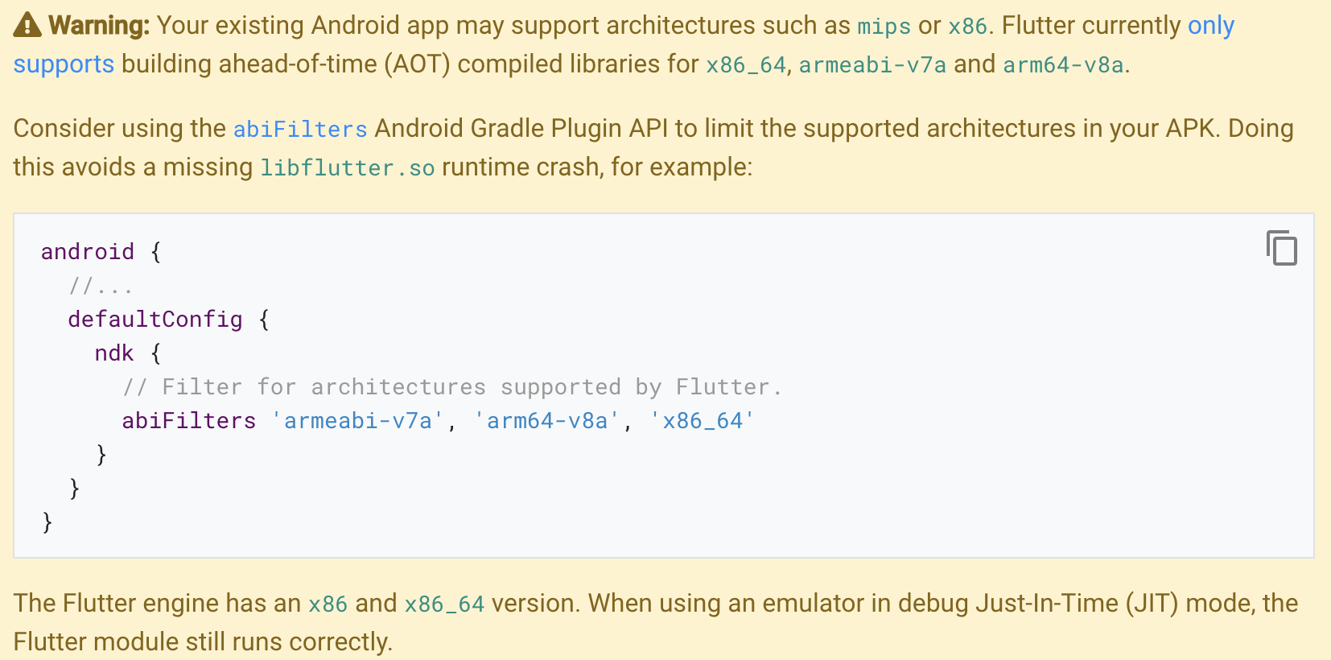

Slide 10
Using Android Studio
The Android Studio IDE is a convenient way of integrating your Flutter module automatically.
With Android Studio, you can co-edit both your Android code and your Flutter code in the same project.
You can also continue to use your normal IntelliJ Flutter plugin functionalities such as Dart code completion, hot reload, and widget inspector.

Slide 11
Using the File > New > New Module... menu in Android Studio in your existing Android project, you can either create a new Flutter module to integrate, or select an existing Flutter module that was created previously.

Slide 12
If you create a new module, you can use a wizard to select the module name, location, and so on.

Slide 13
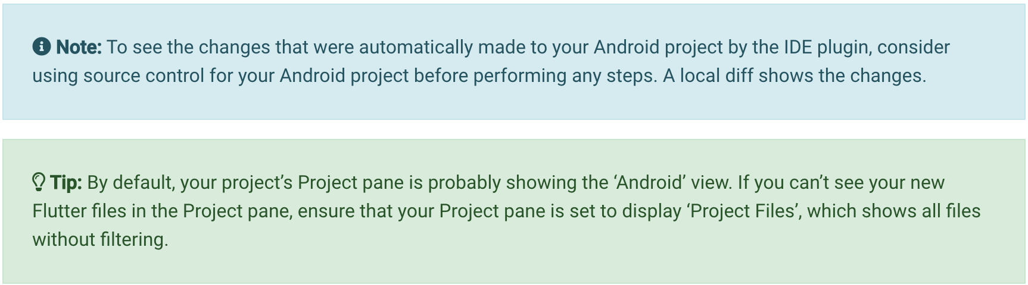
The Android Studio plugin automatically configures your Android project to add your Flutter module as a dependency, and your app is ready to build.

Slide 14
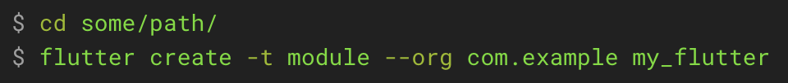
Manual integration
Create a Flutter module
Let’s assume that you have an existing Android app at some/path/MyApp, and that you want your Flutter project as a sibling:
This creates a some/path/my_flutter/ Flutter module project with some Dart code to get you started and a .android/ hidden subfolder.

Slide 15
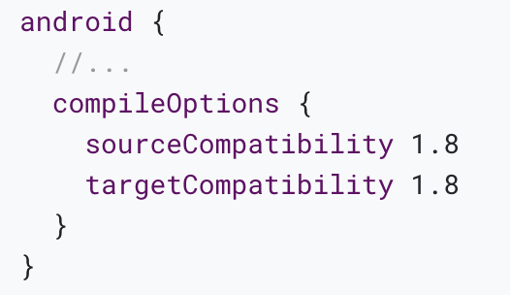
Java 8 requirement
The Flutter Android engine uses Java 8 features.
Before attempting to connect your Flutter module project to your host Android app, ensure that your host Android app declares the following source compatibility within your app’s build.gradle file, under the android { } block

Slide 16
Add the Flutter module as a dependency
Next, add the Flutter module as a dependency of your existing app in Gradle. There are two ways to achieve this.
The AAR mechanism creates generic Android AARs as intermediaries that packages your Flutter module.
This is good when your downstream app builders don’t want to have the Flutter SDK installed. But, it adds one more build step if you build frequently.

Slide 17
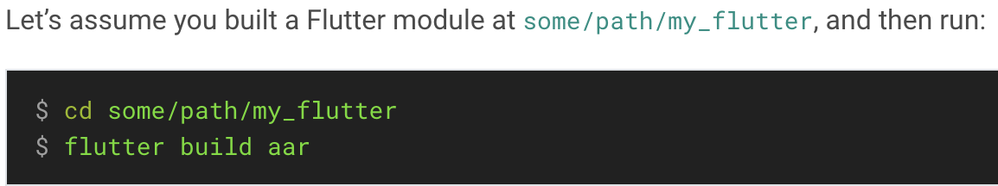
Option A - Depend on the Android Archive (AAR)
This option packages your Flutter library as a generic local Maven repository composed of AARs and POMs artifacts.
This option allows your team to build the host app without installing the Flutter SDK.

Slide 18
Then, follow the on-screen instructions to integrate.

Slide 19
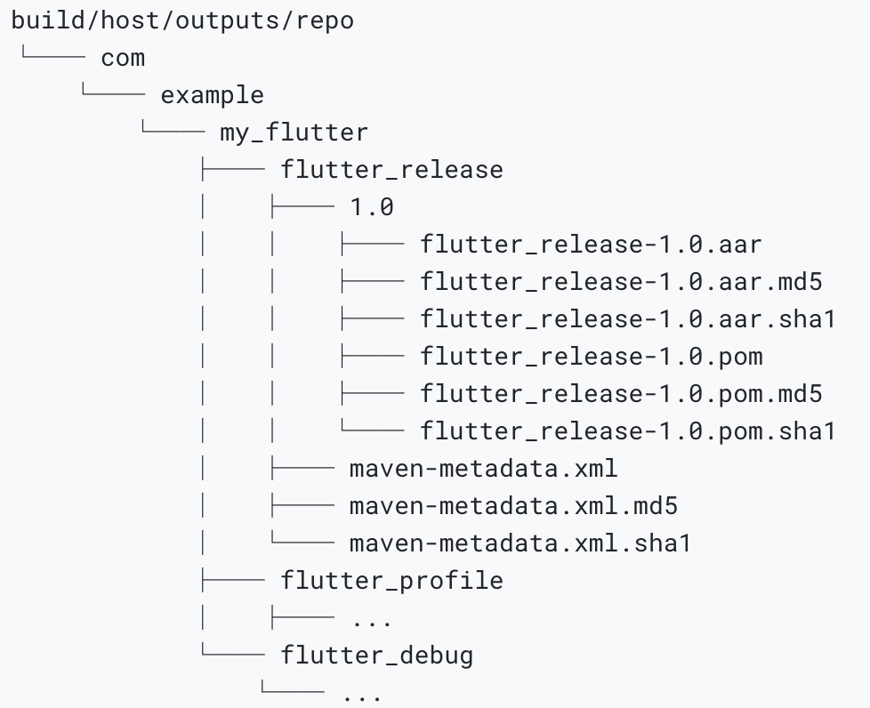
More specifically, this command creates a local repository, with the following files:

Slide 20
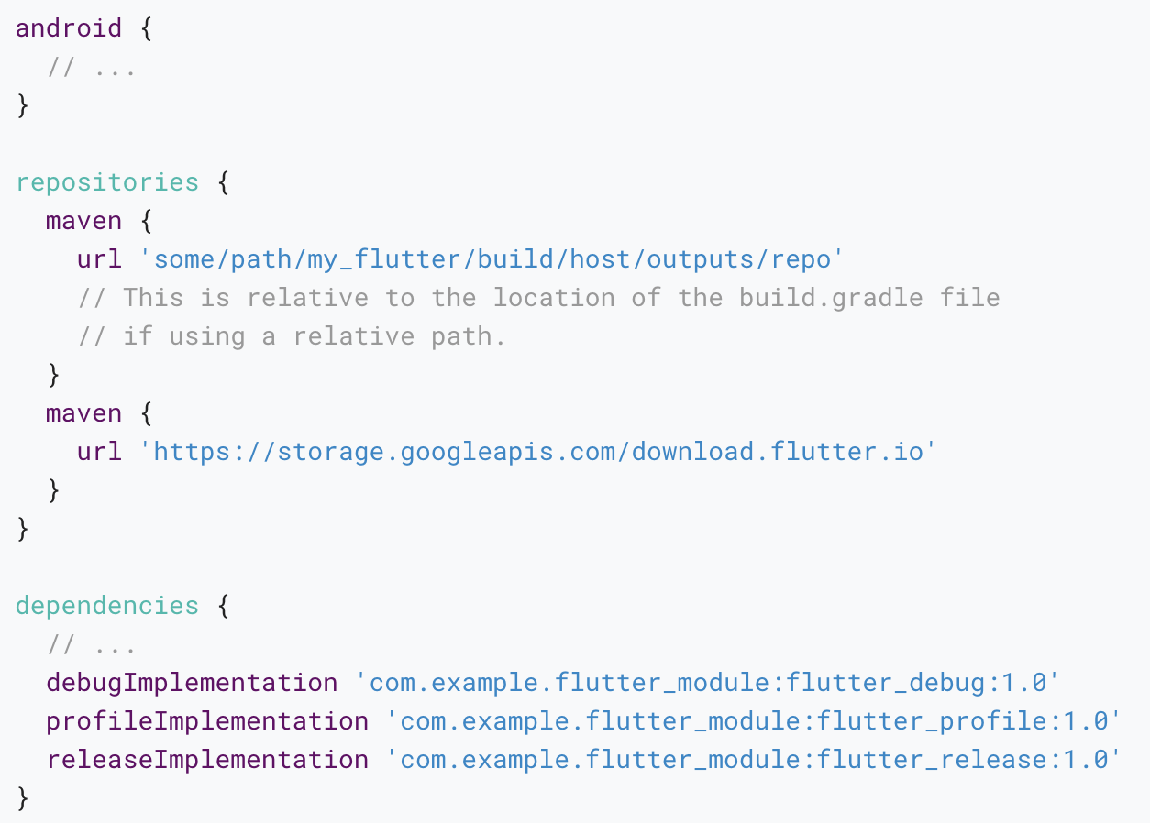
To depend on the AAR, the host app must be able to find these files.
To do that, edit app/build.gradle in your host app such as it includes the local repository and the dependency:

Slide 21
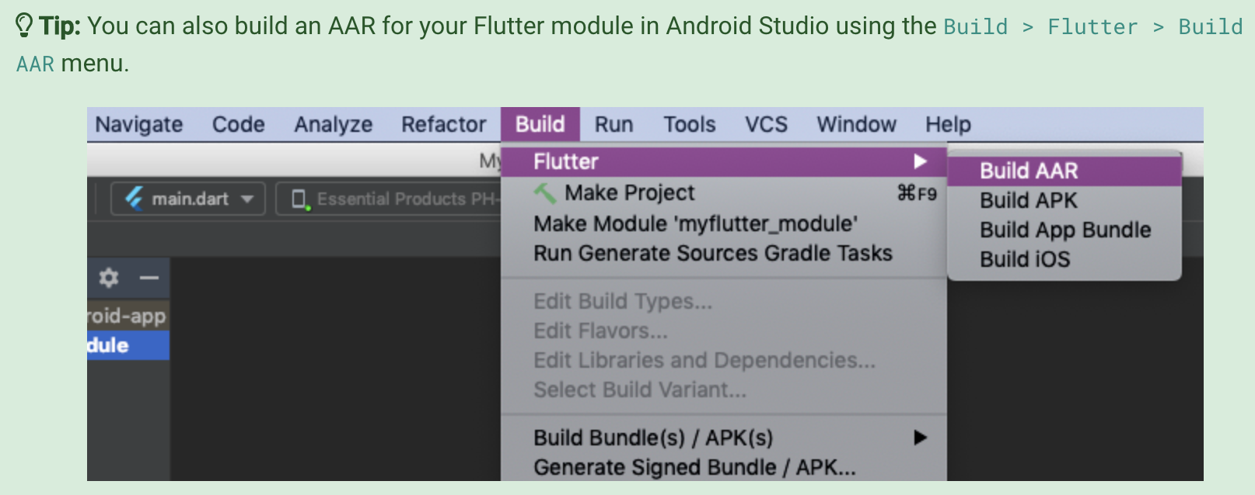
Your app now includes the Flutter module as a dependency. You can follow the next steps in the API usage documentations.

Slide 22
Option B - Depend on the module’s source code
This option enables a one-step build for both your Android project and Flutter project.
This option is convenient when you work on both parts simultaneously and rapidly iterate, but your team must install the Flutter SDK to build the host app.

Slide 23
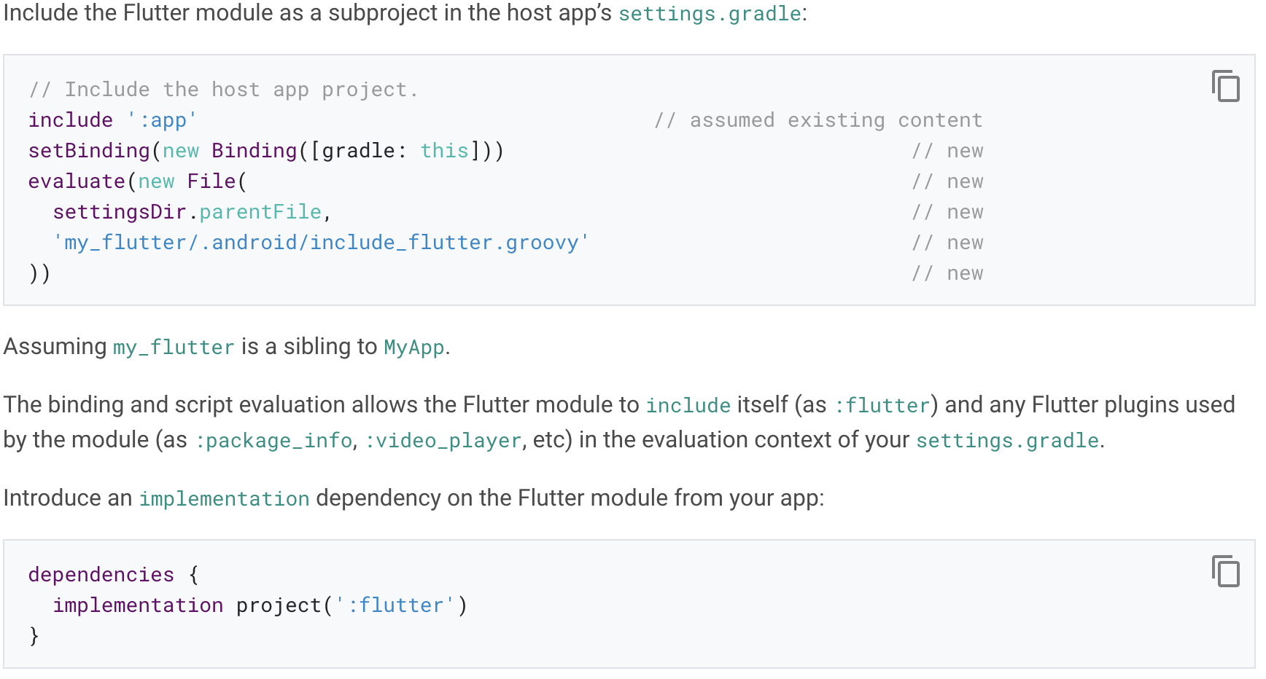

Slide 24
Adding a Flutter screen to an Android app
This guide describes how to add a single Flutter screen to an existing Android app.
A Flutter screen can be added as a normal, opaque screen, or as a see-through, translucent screen. Both options are described in this guide.

Slide 25
Add a normal Flutter screen

Slide 26
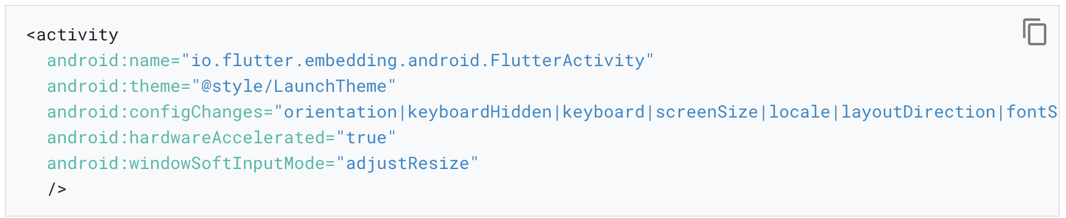
Step 1: Add FlutterActivity to AndroidManifest.xml

Slide 27
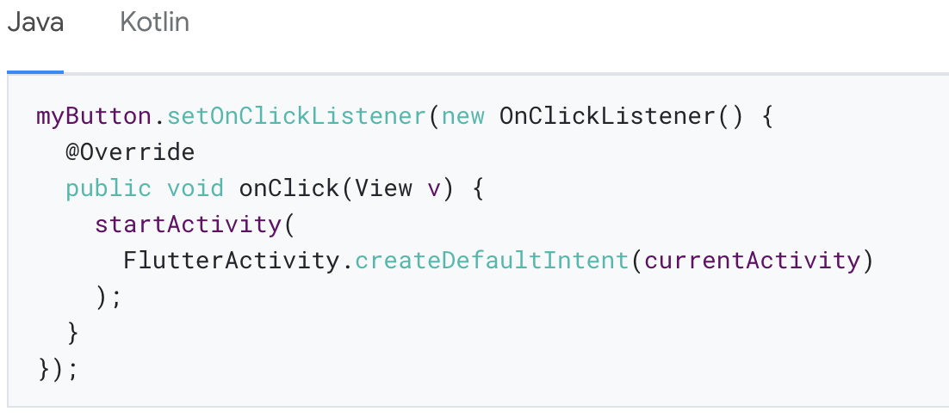
Step 2: Launch FlutterActivity
The following example shows FlutterActivity being launched from an OnClickListener.

Slide 28
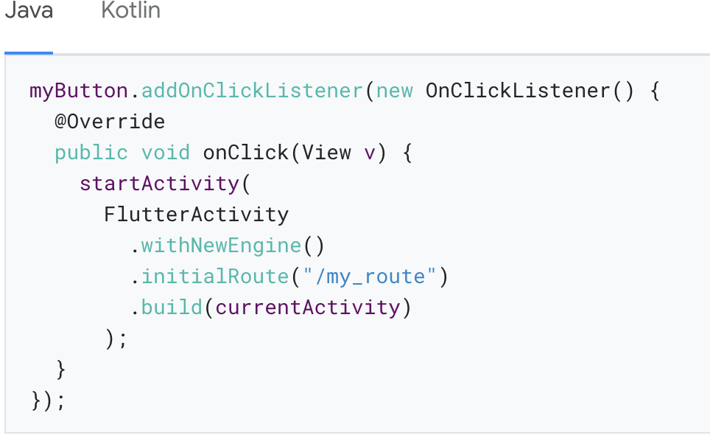
The following example demonstrates how to launch a FlutterActivity that initially renders a custom route in Flutter.

Slide 29
Step 3: (Optional) Use a cached FlutterEngine
Every FlutterActivity creates its own FlutterEngine by default. Each FlutterEngine has a non-trivial warm-up time.
This means that launching a standard FlutterActivity comes with a brief delay before your Flutter experience becomes visible.

Slide 30
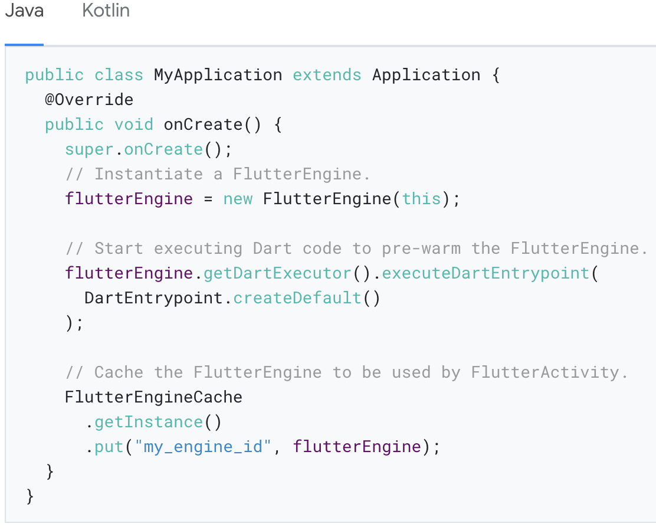
The following example arbitrarily pre-warms a FlutterEngine in the Application class:

Slide 31
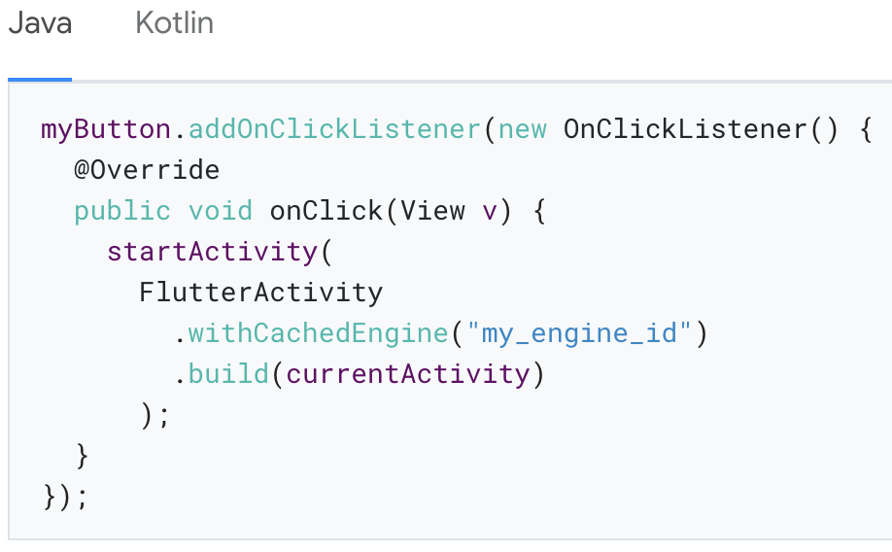
With a pre-warmed, cached FlutterEngine, you now need to instruct your FlutterActivity to use the cached FlutterEngine instead of creating a new one.

Slide 32
Initial route with a cached engine
The concept of an initial route is available when configuring a FlutterActivity or a FlutterFragment with a new FlutterEngine.
Developers that would like their cached engine to begin with a custom initial route can configure their cached FlutterEngine to use a custom initial route just before executing the Dart entrypoint.

Slide 33
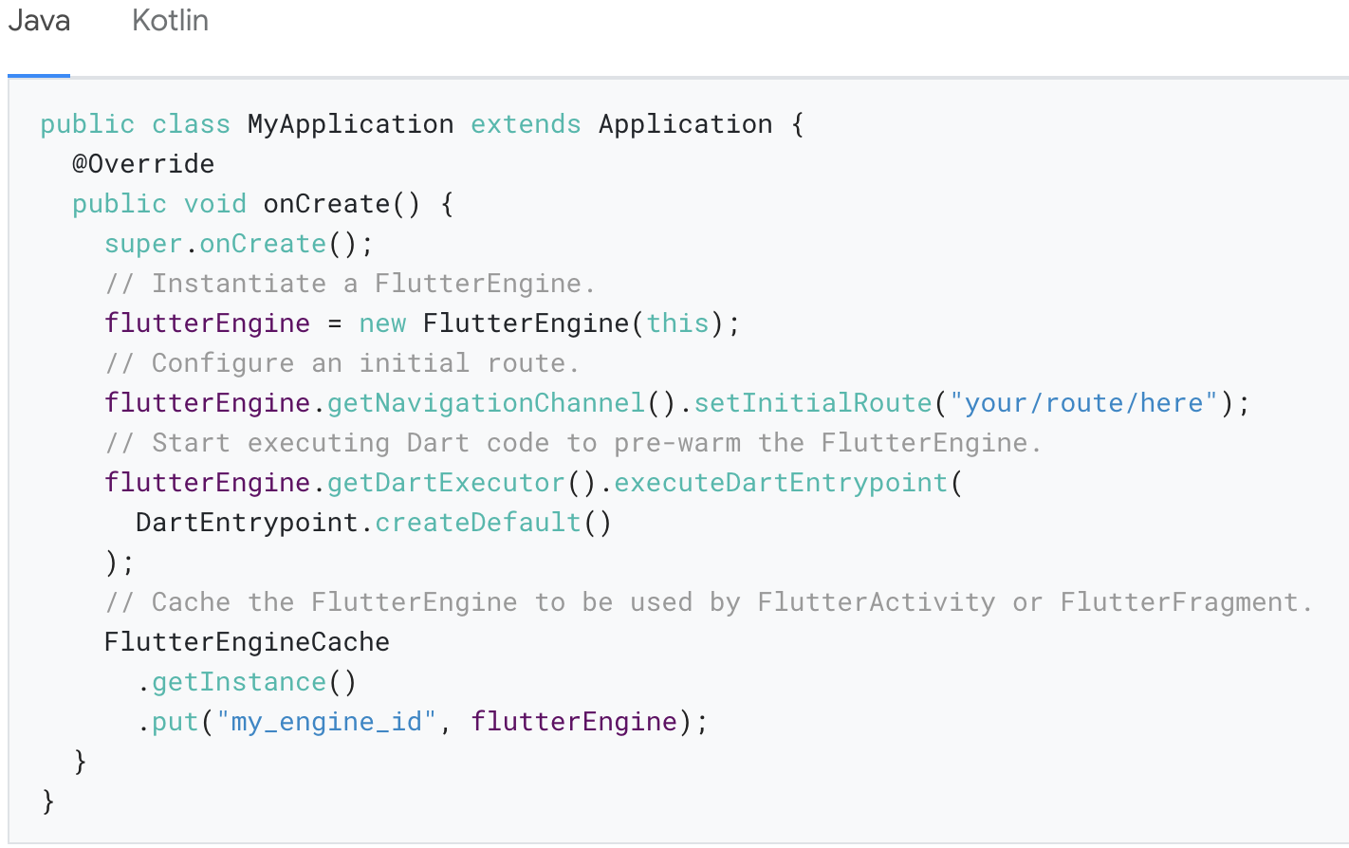
The following example demonstrates the use of an initial route with a cached engine:

Slide 34
Add a translucent Flutter screen

Slide 35
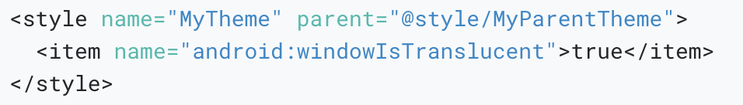
Step 1: Use a theme with translucency
Android requires a special theme property for Activitys that render with a translucent background.
Create or update an Android theme with the following property:

Slide 36
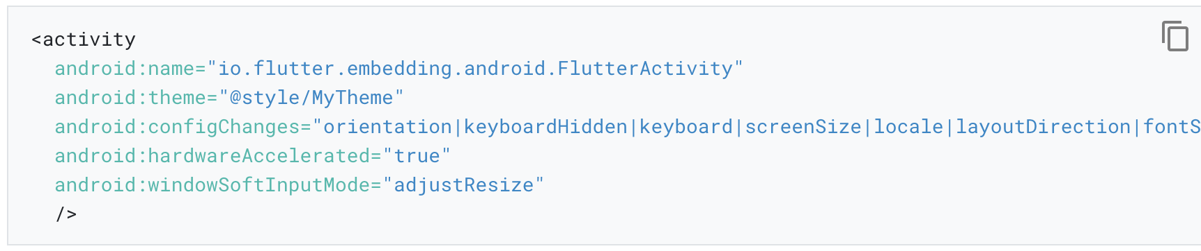
Then, apply the translucent theme to your FlutterActivity.

Slide 37
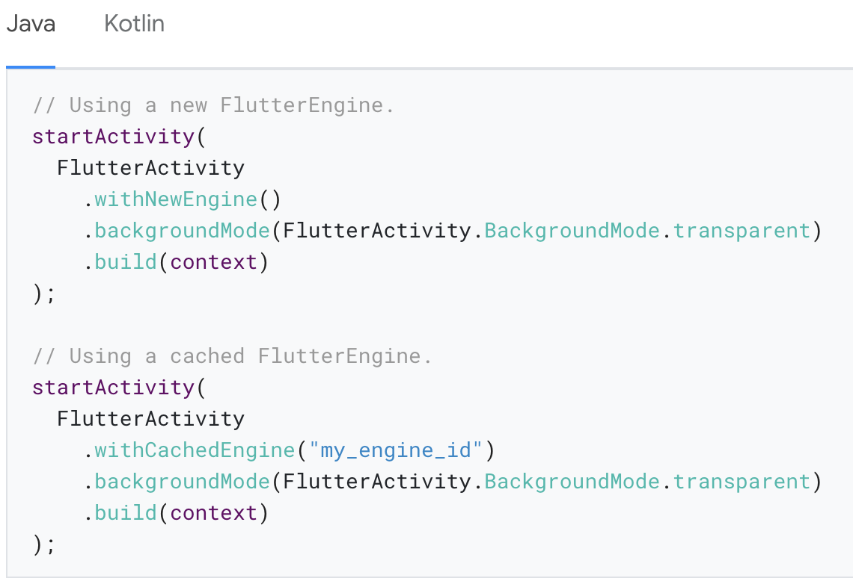
Step 2: Start FlutterActivity with transparency
To launch your FlutterActivity with a transparent background, pass the appropriate BackgroundMode to the IntentBuilder:

Slide 38
Adding a Flutter Fragment to an Android app

Slide 39
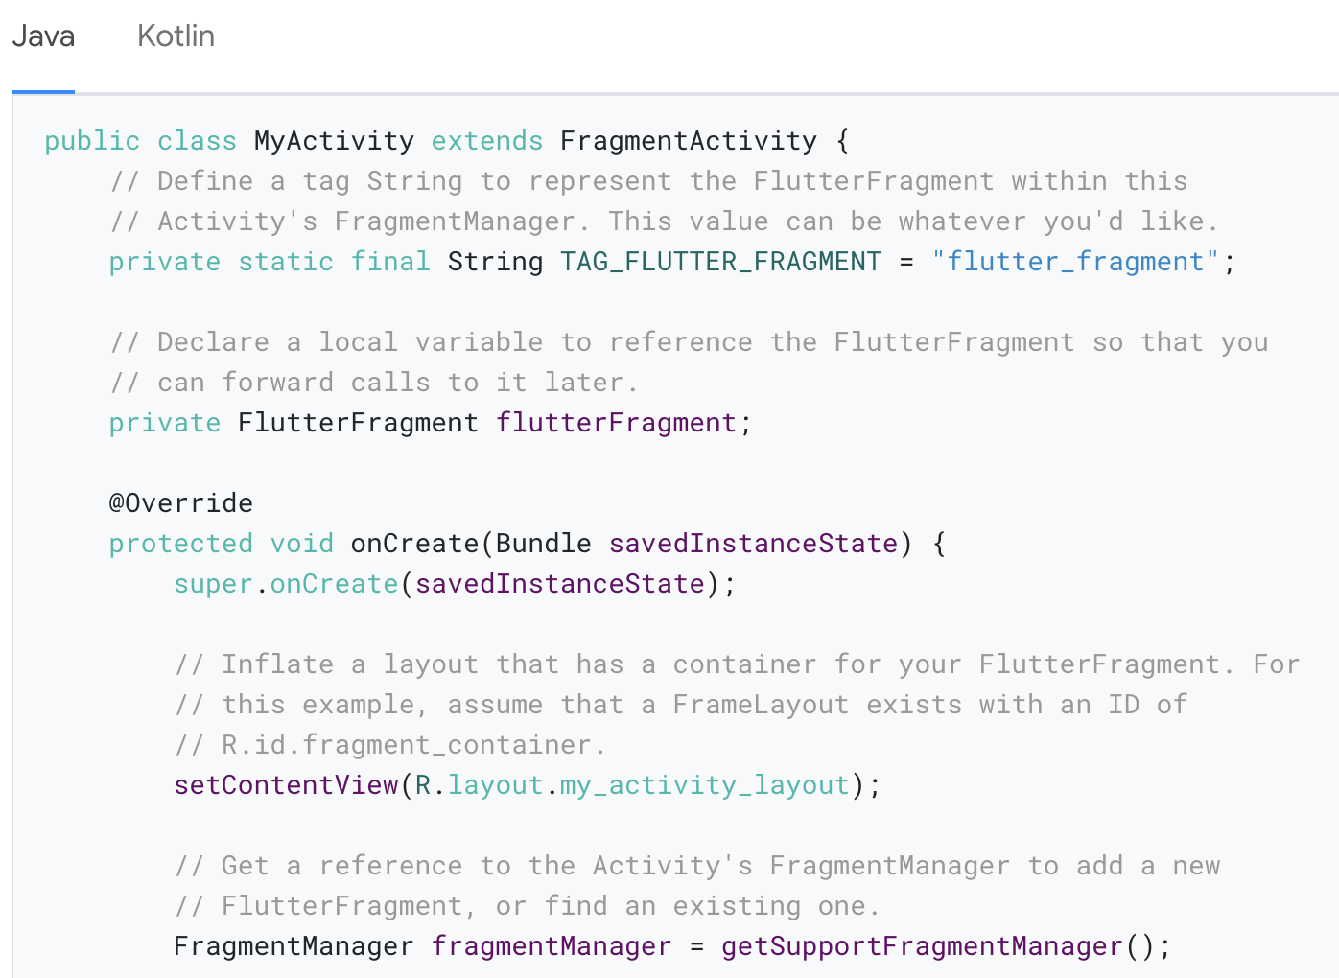
Add a FlutterFragment to an Activity
The first thing to do to use a FlutterFragment is to add it to a host Activity.

Slide 40
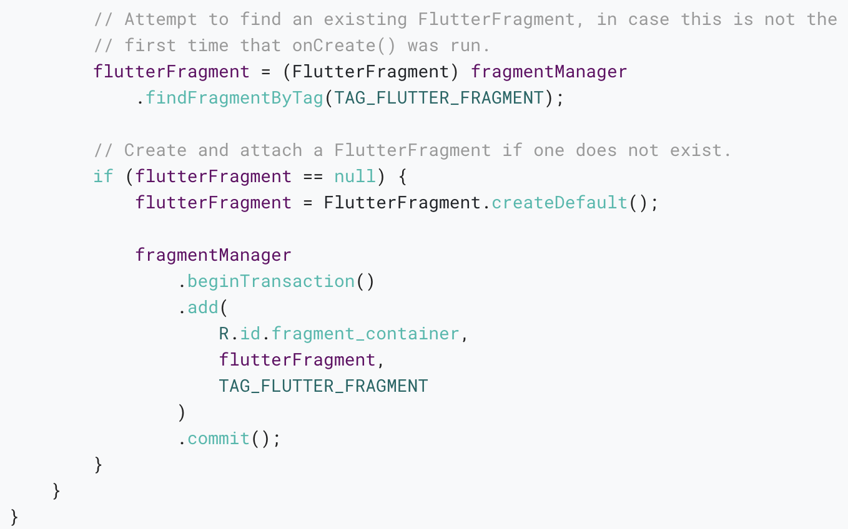

Slide 41
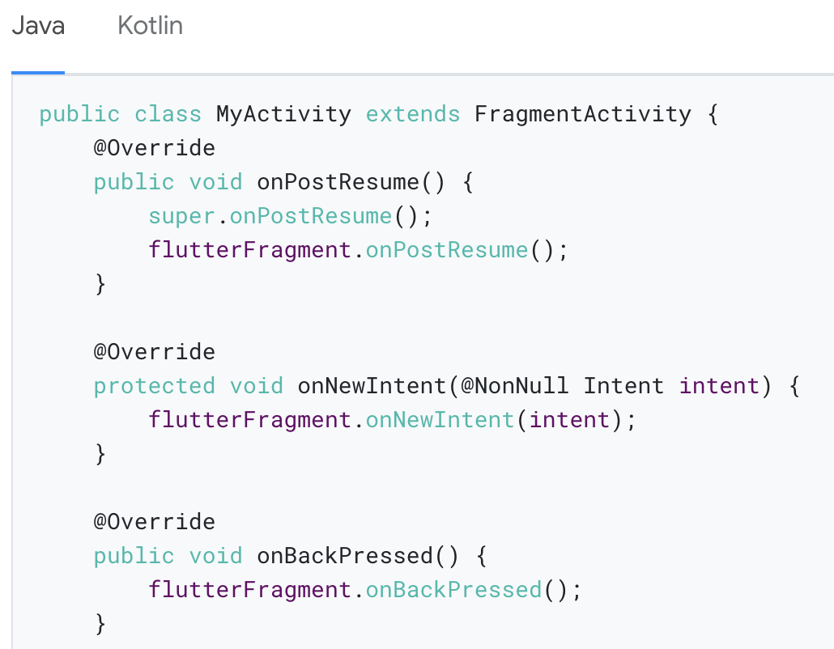
Flutter depends on various OS signals that must be forwarded from your host Activity to FlutterFragment.

Slide 42
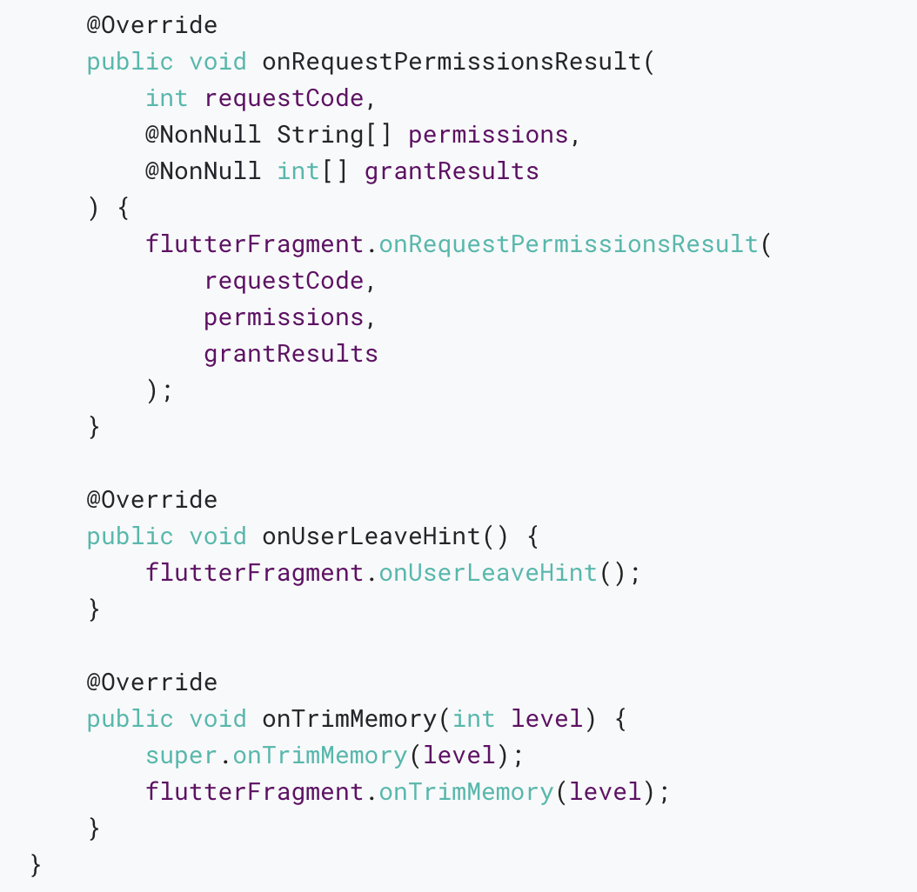

Slide 43
Using a pre-warmed FlutterEngine
By default, a FlutterFragment creates its own instance of a FlutterEngine, which requires non-trivial warm-up time.
This means your user sees a blank Fragment for a brief moment.
You can mitigate most of this warm-up time by using an existing, pre-warmed instance of FlutterEngine.

Slide 44
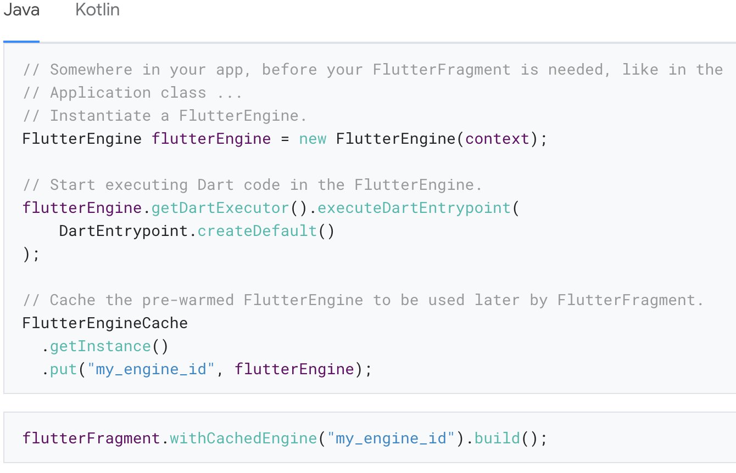
To use a pre-warmed FlutterEngine in a FlutterFragment, instantiate a FlutterFragment with the withCachedEngine() factory method.

Slide 45
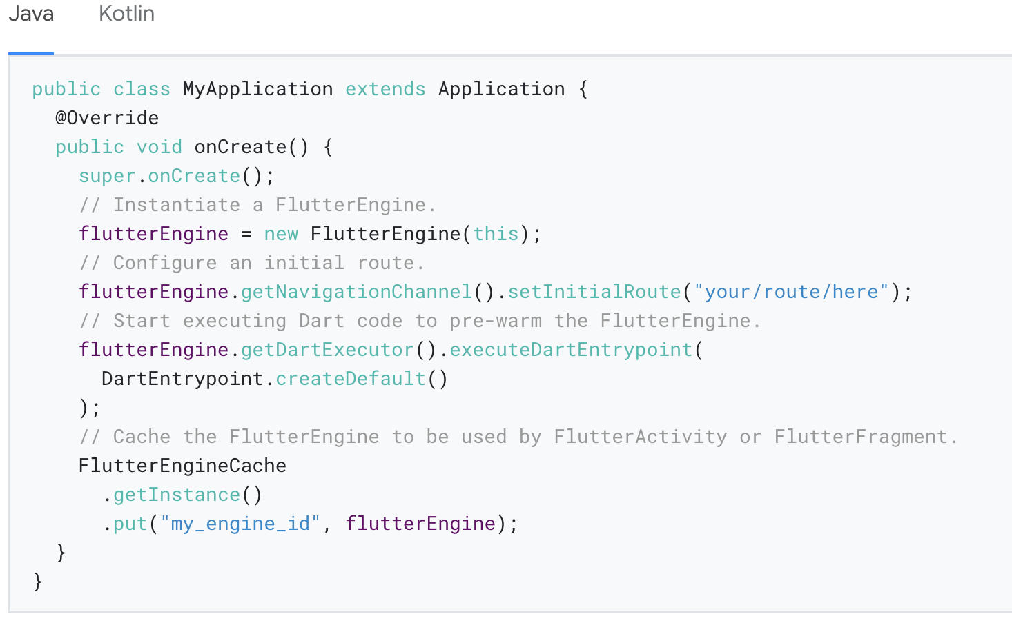
Initial route with a cached engine

Slide 46
Display a splash screen
The initial display of Flutter content requires some wait time, even if a pre-warmed FlutterEngine is used.
To help improve the user experience around this brief waiting period, Flutter supports the display of a splash screen until Flutter renders its first frame.
For instructions about how to show a splash screen, see the Android splash screen guide.

Slide 47
Run Flutter with a specified initial route
An Android app might contain many independent Flutter experiences, running in different FlutterFragments, with different FlutterEngines.
In these scenarios, it’s common for each Flutter experience to begin with different initial routes (routes other than /).

Slide 48
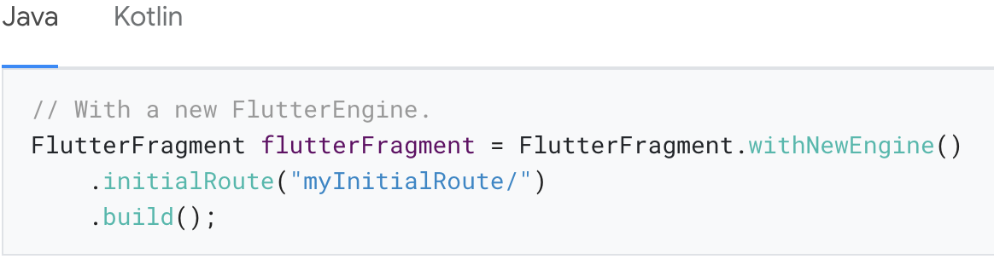
To facilitate this, FlutterFragment’s Builder allows you to specify a desired initial route, as shown:

Slide 49
Run Flutter from a specified entrypoint
Similar to varying initial routes, different FlutterFragments may want to execute different Dart entrypoints.
In a typical Flutter app, there is only one Dart entrypoint: main(), but you can define other entrypoints.
FlutterFragment supports specification of the desired Dart entrypoint to execute for the given Flutter experience.

Slide 50
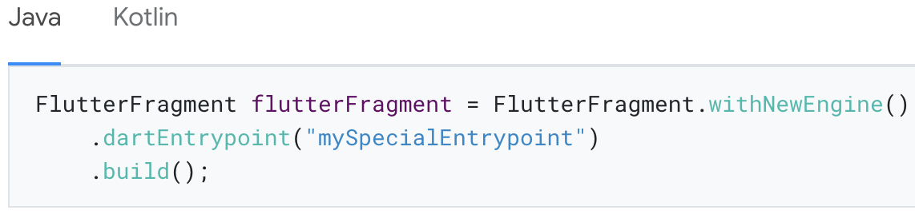
To specify an entrypoint, build FlutterFragment, as shown:

Slide 51
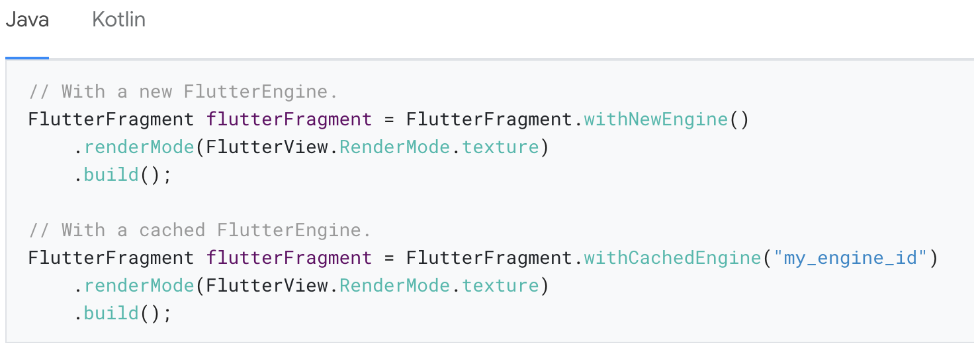
Control FlutterFragment’s render mode
FlutterFragment can either use a SurfaceView to render its Flutter content, or it can use a TextureView.
The default is SurfaceView, which is significantly better for performance than TextureView.

Slide 52
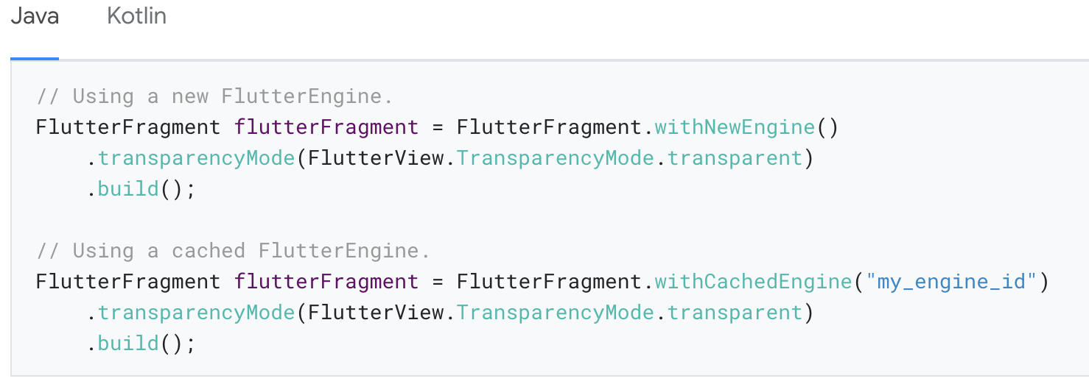
Display a FlutterFragment with transparency
Flutter supports translucency in a FlutterFragment.
To enable transparency for a FlutterFragment, build it with the following configuration:

Slide 53
FlutterFragment and its Activity
Some apps choose to use Fragments as entire Android screens. In these apps, it would be reasonable for a Fragment to control system chrome like Android’s status bar, navigation bar, and orientation.

Slide 54
In other apps, Fragments are used to represent only a portion of a UI. A FlutterFragment might be used to implement the inside of a drawer, a video player, or a single card.

Slide 55
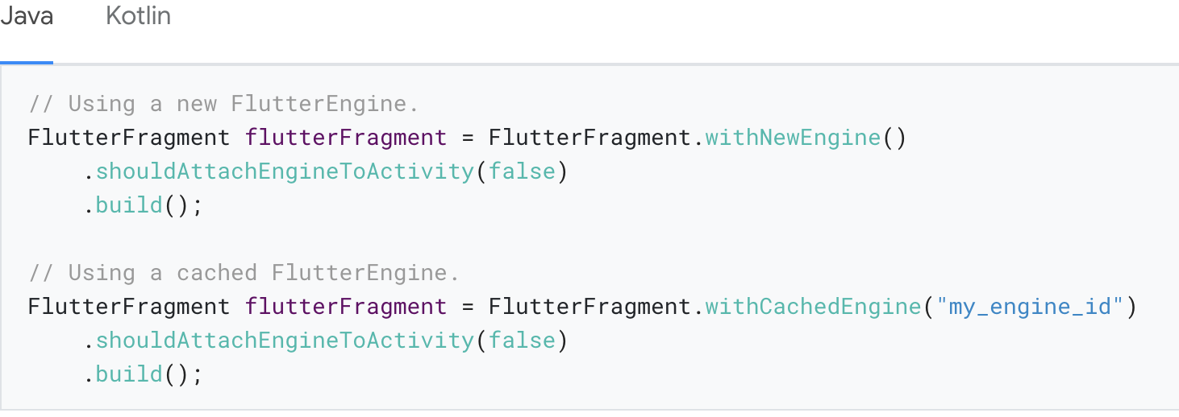
To prevent a FlutterFragment from exposing its Activity to Flutter plugins, and to prevent Flutter from controlling the Activity’s system UI, use the shouldAttachEngineToActivity() method in FlutterFragment’s Builder, as shown:

Slide 56
Adding Flutter to iOS
Notes:
StatelessWidget is used for immutable elements that only rely on the object configuration information
StatefulWidget is used for elements that can dynamically change based on state-changes in the system
Everytime that state changes, setChange() is called by the object

Slide 57
System requirements
Your development environment must meet the macOS system requirements for Flutter with Xcode installed.
Flutter supports iOS 8.0 and later.

Slide 58
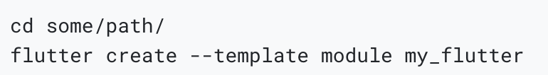
Create a Flutter module
To embed Flutter into your existing application, first create a Flutter module.
From the command line, run:

Slide 59
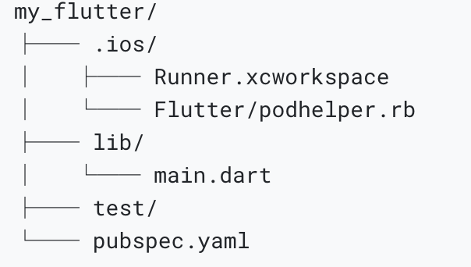
Module organization
The my_flutter module directory structure is similar to a normal Flutter application:
Add your Dart code to the lib/ directory.
Add Flutter dependencies to my_flutter/pubspec.yaml, including Flutter packages and plugins.
The .ios/ hidden subfolder contains an Xcode workspace where you can run a standalone version of your module.

Slide 60
Embed the Flutter module
There are two ways to embed Flutter in your existing application.
Use the CocoaPods dependency manager and installed Flutter SDK. (Recommended.)
Create frameworks for the Flutter engine, your compiled Dart code, and all Flutter plugins. Manually embed the frameworks, and update your existing application’s build settings in Xcode.

Slide 61
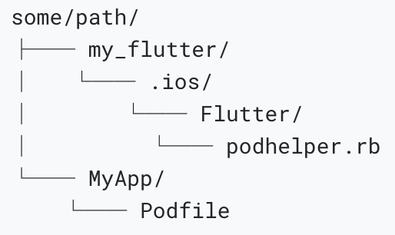
Option A - Embed with CocoaPods and the Flutter SDK
This method requires every developer working on your project to have a locally installed version of the Flutter SDK.
The following example assumes that your existing application and the Flutter module are in sibling directories. If you have a different directory structure, you may need to adjust the relative paths.

Slide 62
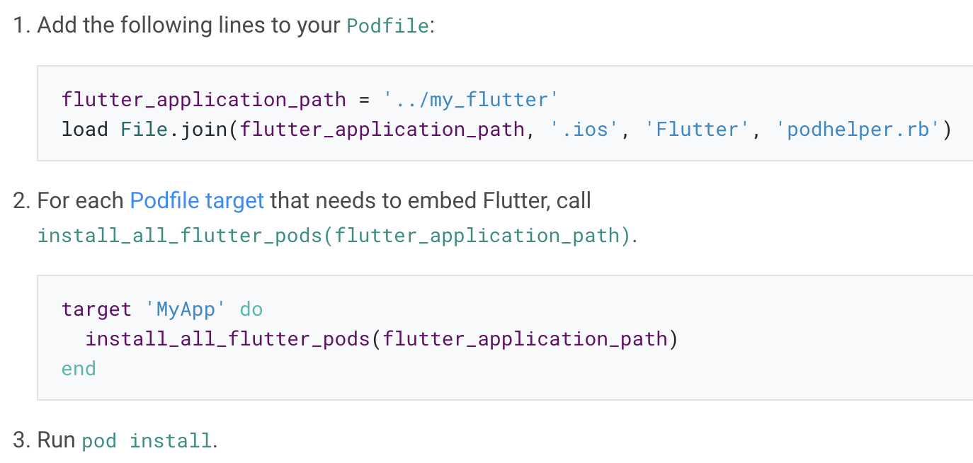
If your existing application (MyApp) doesn’t already have a Podfile, follow the CocoaPods getting started guide to add a Podfile to your project.

Slide 63
Option B - Embed frameworks in Xcode
Alternatively, you can generate the necessary frameworks and embed them in your application by manually editing your existing Xcode project.
The following example assumes that you want to generate the frameworks to some/path/MyApp/Flutter/.

Slide 64
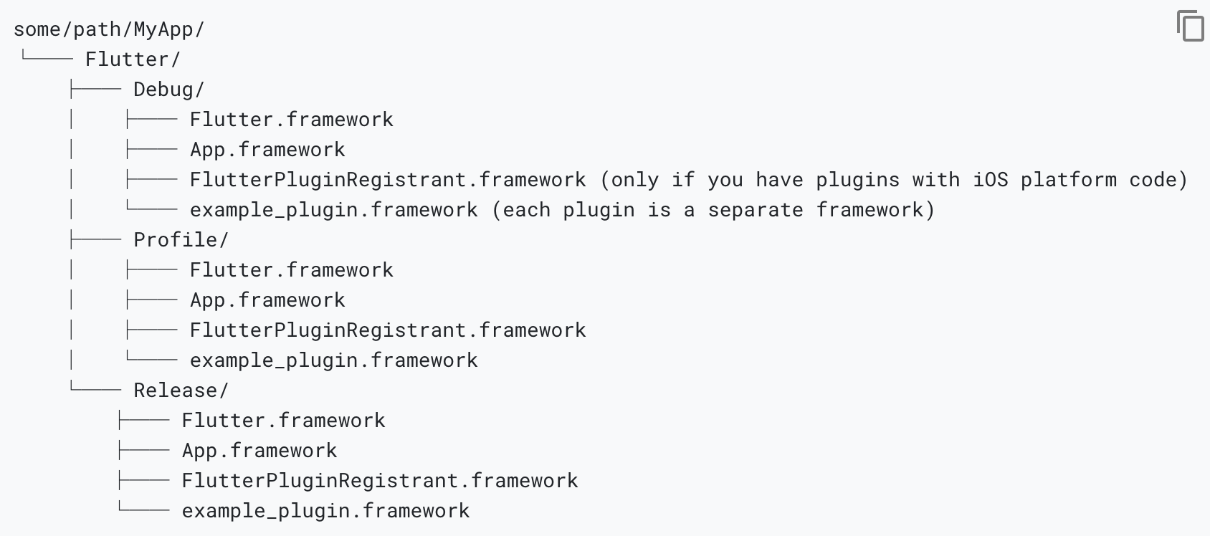

Slide 65
Link on the frameworks
For example, you can drag the frameworks from some/path/MyApp/Flutter/Release/ in Finder into your targets’ build settings > Build Phases > Link Binary With Libraries.

Slide 66
In the target’s build settings, add $(PROJECT_DIR)/Flutter/Release/ to the Framework Search Paths (FRAMEWORK_SEARCH_PATHS).

Slide 67
Embed the frameworks
The generated dynamic frameworks must be embedded into your app to be loaded at runtime.
For example, you can drag the framework from your application’s Frameworks group into your targets’ build settings > Build Phases > Embed Frameworks.

Slide 69
Option C - Embed application and plugin frameworks in Xcode and Flutter framework with CocoaPods
Alternatively, instead of distributing the large Flutter.framework to other developers, machines, or continuous integration systems, you can instead generate Flutter as CocoaPods podspec by adding the flag --cocoapods.

Slide 70
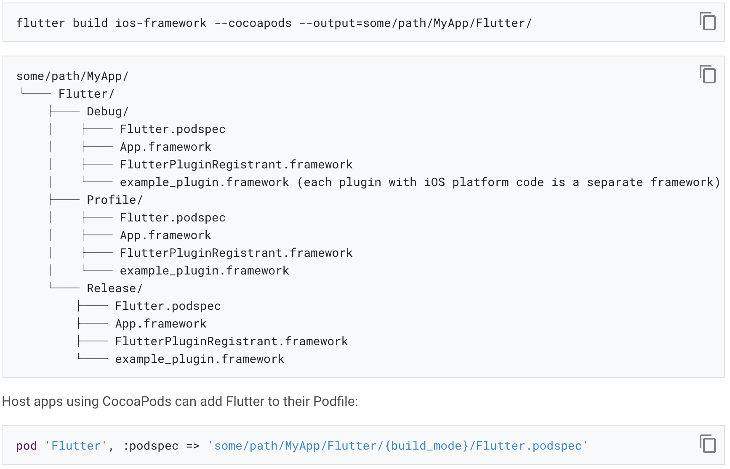

Slide 71
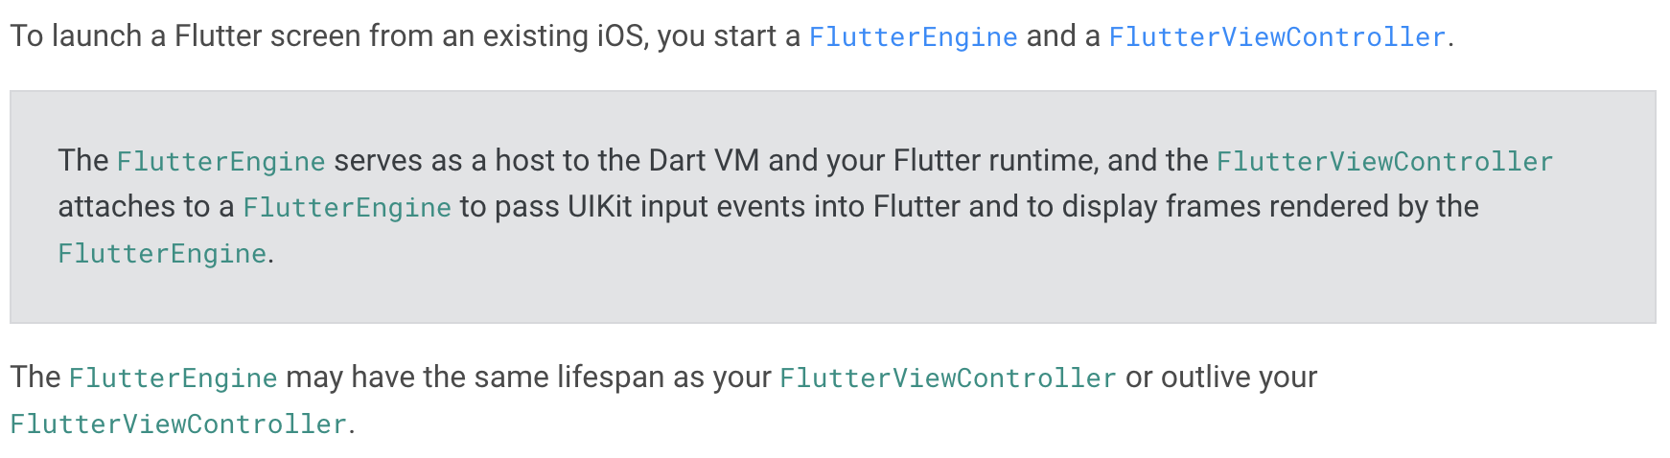
Adding a Flutter screen to an iOS app
Start a FlutterEngine and FlutterViewController

Slide 72
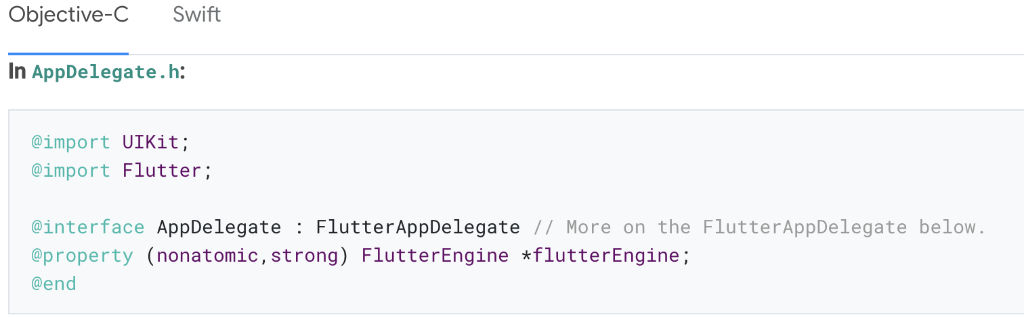
Create a FlutterEngine
The proper place to create a FlutterEngine is specific to your host app.
As an example, we demonstrate creating a FlutterEngine, exposed as a property, on app startup in the app delegate.

Slide 73
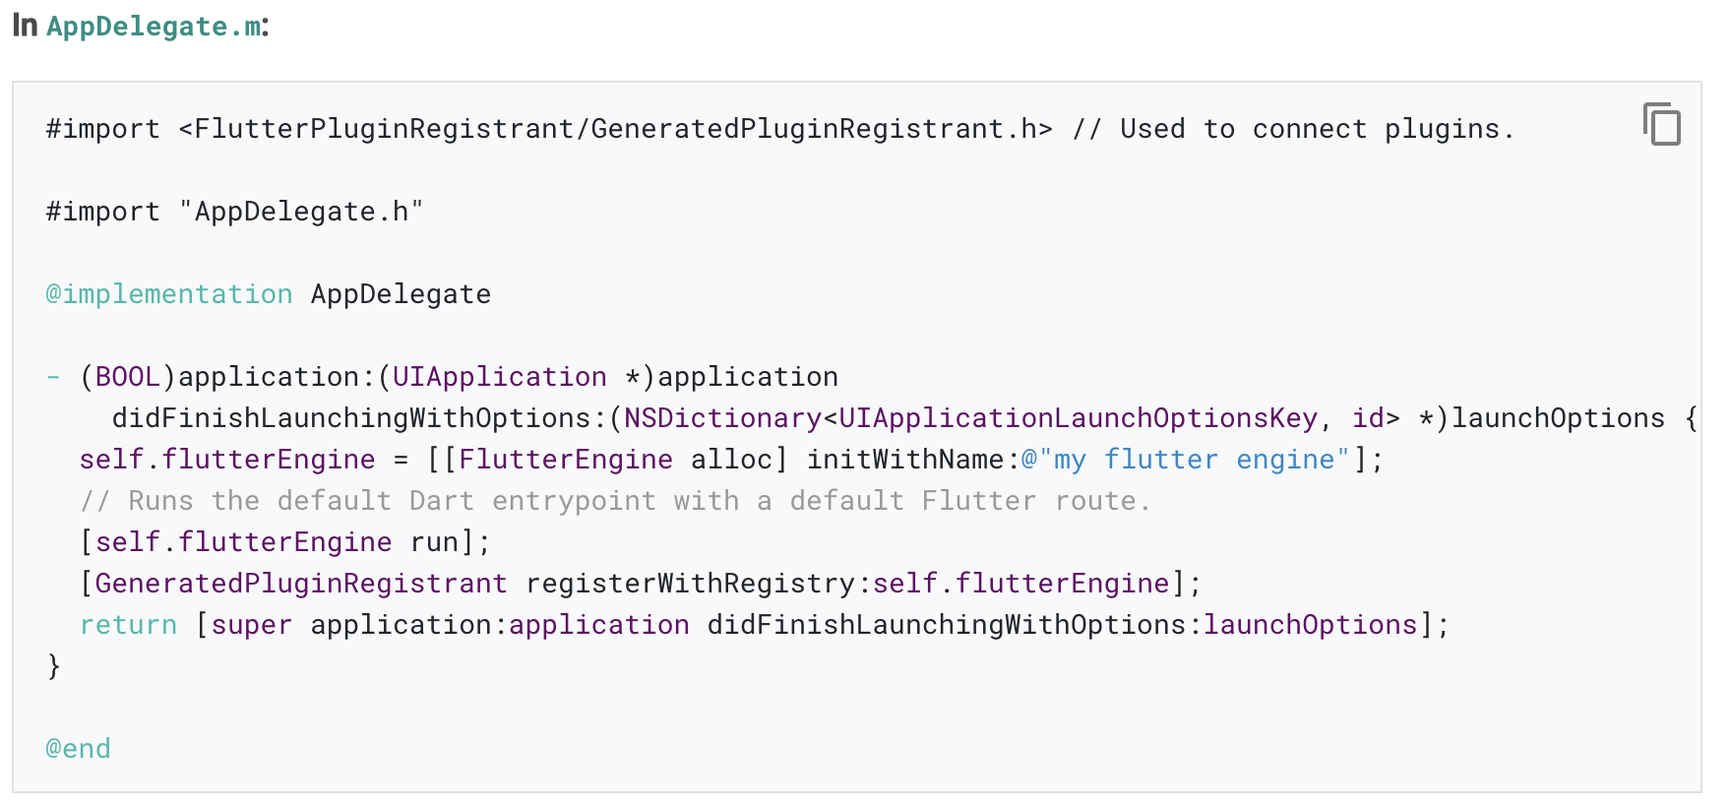

Slide 74
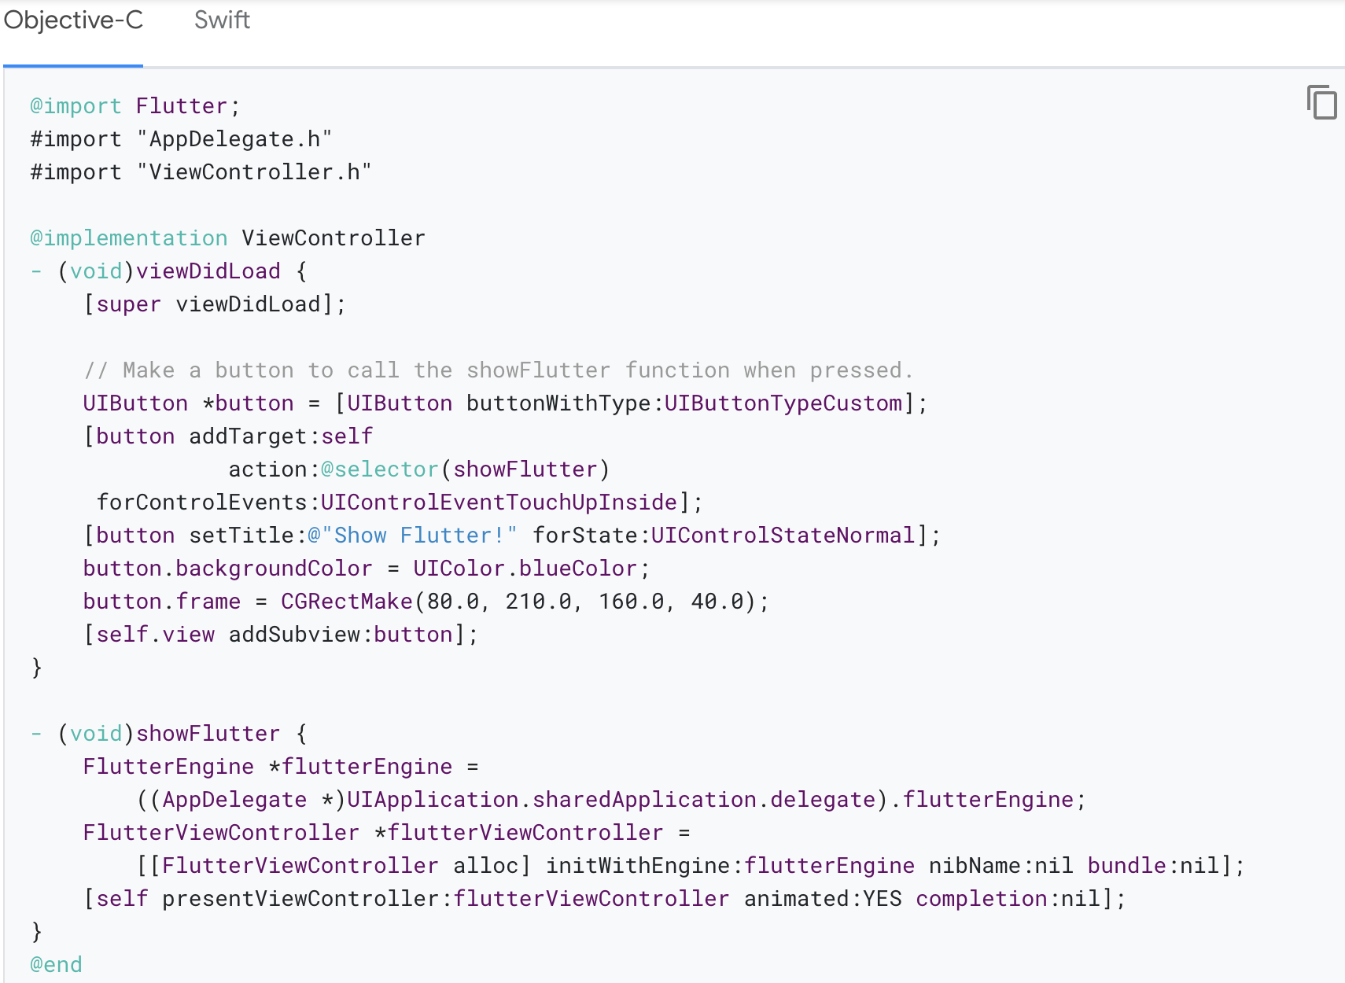
Show a FlutterViewController with your FlutterEngine
The following example shows a generic ViewController with a UIButton hooked to present a FlutterViewController.

Slide 75
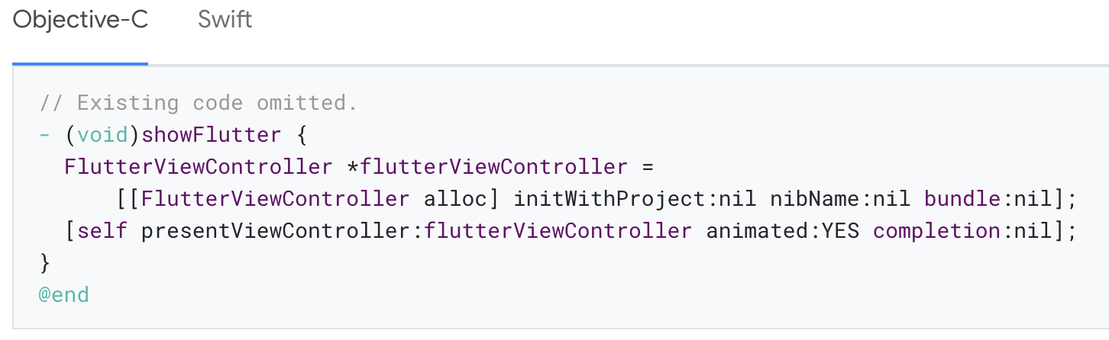
Alternatively - Create a FlutterViewController with an implicit FlutterEngine
As an alternative to the previous example, you can let the FlutterViewController implicitly create its own FlutterEngine without pre-warming one ahead of time.

Slide 76
Using the FlutterAppDelegate
Letting your application’s UIApplicationDelegate subclass FlutterAppDelegate is recommended but not required.
The FlutterAppDelegate performs functions such as:
Forwarding application callbacks such as openURL to plugins such as local_auth.
Forwarding status bar taps (which can only be detected in the AppDelegate) to Flutter for scroll-to-top behavior.

Slide 77
Launch options
Dart entrypoint
Calling run on a FlutterEngine, by default, runs the main() Dart function of your lib/main.dart file.
You can also run a different entrypoint function by using runWithEntrypoint with an NSString specifying a different Dart function.

Slide 78
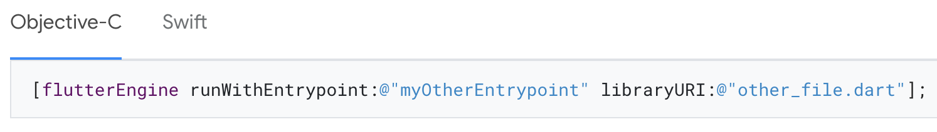
Dart library
In addition to specifying a Dart function, you can specify an entrypoint function in a specific file.
For instance the following runs myOtherEntrypoint() in lib/other_file.dart instead of main() in lib/main.dart:

Slide 79
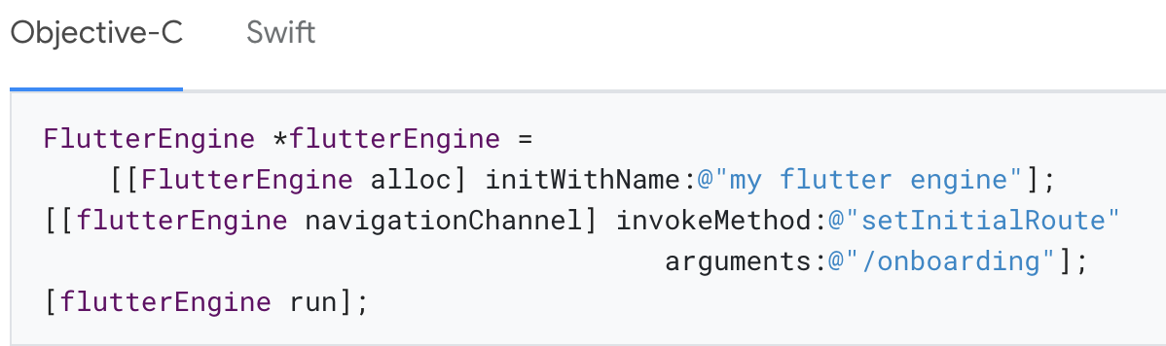
Route
An initial route can be set for your Flutter WidgetsApp when constructing the engine.

Slide 80
Other
The previous example only illustrates a few ways to customize how a Flutter instance is initiated.
Using platform channels, you’re free to push data or prepare your Flutter environment in any way you’d like, before presenting the Flutter UI using a FlutterViewController.

Slide 81
Running, debugging, and hot reload
Notes:
StatelessWidget is used for immutable elements that only rely on the object configuration information
StatefulWidget is used for elements that can dynamically change based on state-changes in the system
Everytime that state changes, setChange() is called by the object

Slide 82
Running, debugging, and hot reload
Once you’ve integrated the Flutter module to your project and used Flutter’s platform APIs to run the Flutter engine and/or UI, you can then build and run your Android or iOS app the same way you run normal Android or iOS apps.

Slide 83
Debugging
You may be used to having your suite of favorite Flutter debugging tools available to you automatically when running flutter run or an equivalent command from an IDE.
But you can also use all your Flutter debugging functionalities such as hot reload, performance overlays, DevTools, and setting breakpoints in add-to-app scenarios.

Slide 84
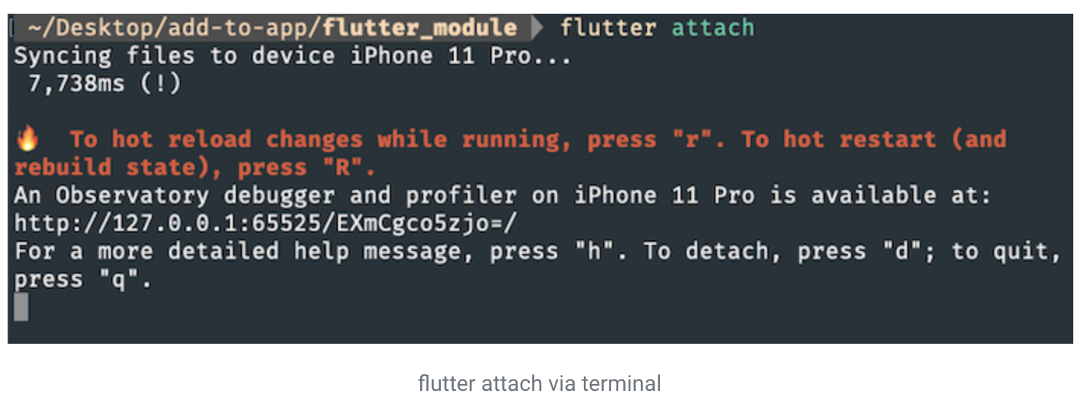
These functionalities are provided by the flutter attach mechanism.

Slide 85
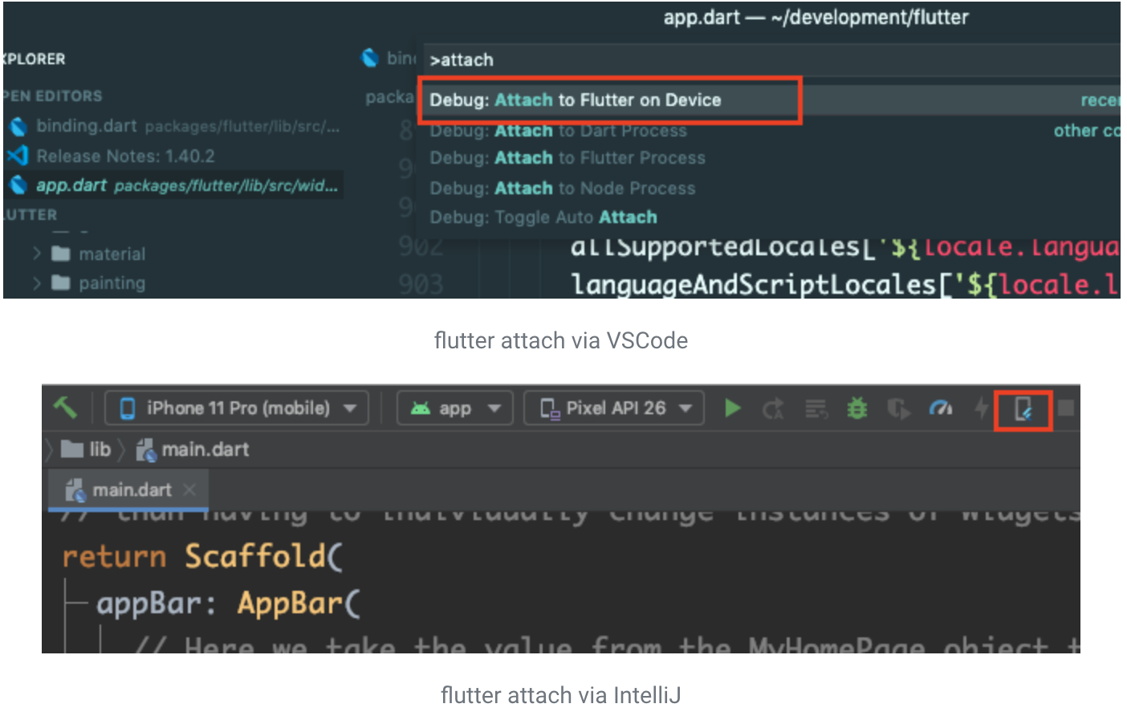

Slide 86
Debugging specific instances of Flutter
It’s possible to add multiple instances of Flutter (root isolates) to an app. flutter attach connects to all of the available isolates by default.
Any commands sent from the attached CLI are then forwarded to each of the attached isolates.

Slide 87
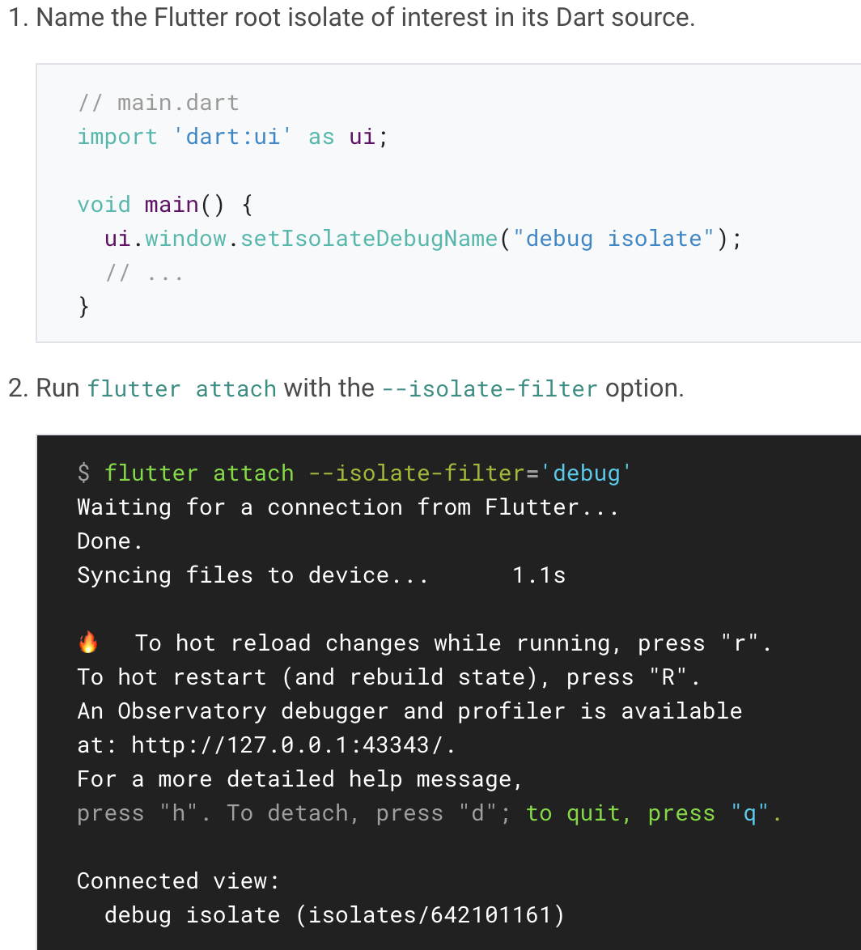
In order to attach to specific isolates instead, do the following:

Slide 88
Load sequence, performance, and memory
Notes:
StatelessWidget is used for immutable elements that only rely on the object configuration information
StatefulWidget is used for elements that can dynamically change based on state-changes in the system
Everytime that state changes, setChange() is called by the object

Slide 89
Loading Flutter
Finding the Flutter resources
Flutter’s engine runtime and your application’s compiled Dart code are both bundled as shared libraries on Android and iOS. The first step of loading Flutter is to find those resources in your .apk/.ipa/.app (along with other Flutter assets such as images, fonts, and JIT code if applicable).
This happens when you construct a FlutterEngine for the first time on both Android and iOS APIs.

Slide 90
Loading the Flutter library
After it’s found, the engine’s shared libraries are memory loaded once per process.
On Android, this also happens when the FlutterEngine is constructed because the JNI connectors need to reference the Flutter C++ library. On iOS, this happens when the FlutterEngine is first run, such as by running runWithEntrypoint:.

Slide 91
Starting the Dart VM
The Dart runtime is responsible for managing Dart memory and concurrency for your Dart code. In JIT mode, it’s additionally responsible for compiling the Dart source code into machine code during runtime.
A single Dart runtime exists per application session on Android and iOS.
A one-time Dart VM start is done when constructing the FlutterEngine for the first time on Android and when running a Dart entrypoint for the first time on iOS.

Slide 92
Creating and running a Dart Isolate
After the Dart runtime is initialized, the Flutter engine’s usage of the Dart runtime is the next step.
On Android, this happens when you call DartExecutor.executeDartEntrypoint() on a FlutterEngine instance.
On iOS, this happens when you call runWithEntrypoint: on a FlutterEngine.

Slide 93
Attaching a UI to the Flutter engine
A standard, full Flutter app moves to reach this state as soon as the app is launched.
In an add-to-app scenario, this happens when you attach a FlutterEngine to a UI component such as by calling startActivity()) with an Intent built using FlutterActivity.withCachedEngine() on Android. Or, by presenting a FlutterViewController initialized by using initWithEngine: nibName: bundle: on iOS.

Slide 94
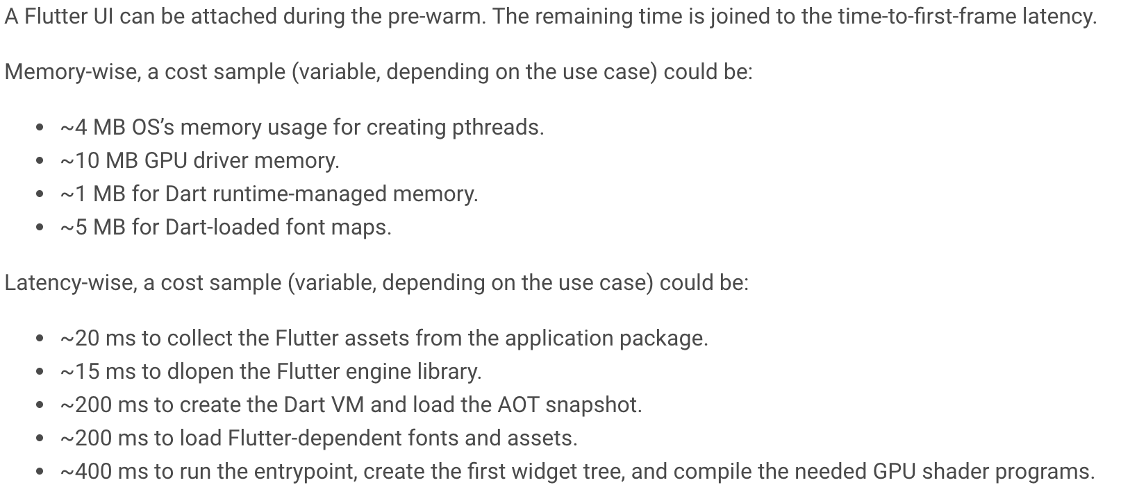
Memory and latency
Showing a Flutter UI has a non-trivial latency cost. This cost can be lessened by starting the Flutter engine ahead of time.

Slide 95
Thank you!
Wenxuan Shi
College of Software, Nankai University
Email: shiwx@nankai.edu.cn
Wechat: 13920561100

